Slide 1
Software Companies
How Affirma Helps
The software industry can be highly complex and dynamic. Keeping up with the competition to provide important and impactful technology and marketing solutions across the globe, while also making employees and customers happy, can be not only challenging—it can seem impossible. Affirma’s dependable, 21st-century solutions help increase workplace efficiency so that your company can focus on what matters most.

Slide 2




Why Should You Work With Affirma?
Four Good Reasons
Affirma has been successfully partnering with software companies for nearly twenty years on many custom technology and digital marketing solutions to provide the latest industry offerings and fill the gaps for needed services. We know some of the major challenges in the software development industry are rapid technology advancement, increasing customer demands, time and bandwidth limitations, and limited infrastructure and resources.
Affirma can help you bring your internal operations and client-facing website and software services to the latest, and most user-friendly platforms so that you can increase workplace efficiency and meet customer demands.
Our customized software industry solutions allow you to shape and create software and business operations to meet your specific needs and solve your pain points. In cases where your solution doesn’t currently exist, custom development allows you to create it from scratch.
Increase Productivity
Streamline Operations
We specialize in Mobile, Cloud, Technology Infrastructure and Custom Development and partner with software companies to remove the manual steps from day-to-day workflow.
We help implement SharePoint, Google, and other setups to help increase workplace efficiency by implementing information architecture, dashboards, Teams and communications sites, permissions and security.
Secure Platforms and Tools
Improve Customer Experience
We specialize in custom tools and process automation and will work directly with software companies to develop internal tools, Wikis, apps, directories, CMS, and/or workflow management systems.
Our creative technology teams work together to create tailored and accessible website and secure client solutions that capture the essence of your brand in a meaningful way and meet your customers’ real-time needs.

Slide 3


Services We Provide
We take the time to learn about your goals, ask the right questions to understand your organization, and utilize our software industry business solutions to help your team move faster. We know how important it is to find the right solutions for your workplace, so your employees’ focus can be on improving customer satisfaction.
Our goal is to unblock teams so that they can focus on their core job responsibilities and clear the road for growth and success.
Technology
Digital Marketing
IT Infrastructure
Design Services
ERP& Line of Business Applications
Content Management Systems
Web & Mobile Applications
Systems Integration
Marketing Automation
Campaign Execution
Copywriting
SEM, SEO, PPC, Social Media
Office 365
Azure & AWS
MMD, Exchange, Active Directory
System Center
User Experience Design
Visual Design
Rapid Prototyping
Journey Mapping
Customer Relationship Management (CRM)
Business Process Outsourcing
Business Intelligence Reporting & Analytics
Portals & Collaboration
SharePoint
Document Management
Business Process Automation
Corporate Communications
Salesforce
Dynamics CRM
HubSpot
Managed Teams
Program Management
Staff Augmentation
Data Visualization
Data Warehousing
Big Data

Slide 4
Digital and Technology
Solutions That Deliver Results
Affirma believes that effective solutions are born from a combination of data, insight, strategy, design, and implementation. We care deeply about the experience of our clients and their customers know that having the right technologies and services in place is crucial to execute deliverables and keep up with a constantly changing marketplace. We consider your entire business to develop customized software solutions tailored for your business.
Our seasoned consulting experts can deliver seamless business solutions, no matter your need.
Happy employees, cost savings, and business growth are just a few examples of the value our software clients gain from our partnership.
We had a great time working with Affirma on our website
design and development project. From design to launch,
they were friendly, quick to respond, and worked hard to
understand and address the goals we wanted to accomplish.
SELCO Community Credit Union

Slide 5
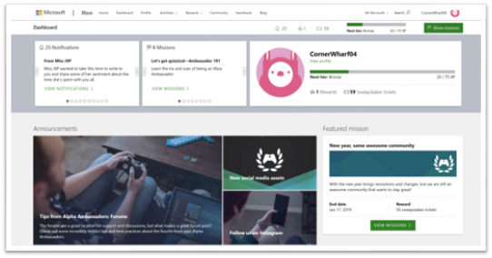
Case Studies
Xbox Ambassadors
What We Did
Affirma partnered with the Xbox Ambassador team to do the following:
Create an eight-person software development team dedicated to XCS, along with two content and social media editors.
Build and maintain the Xbox Ambassador web application and Azure Service Fabric backend platform to provide general .NET and Azure services to support all platform processes and activities.
Create a functional dashboard for the Xbox Ambassadors with leaderboard KPIs.
Establish quarterly seasonal badge driven contests to drive Ambassador participation and service levels.
XA Solutions
Business Need
The Xbox Ambassadors are a community of gamers working together to help the broader gaming community base resolve issues and answer questions. They came to Affirma initially to set up a team that would reduce call center costs because a significant amount service requests were going directly to the Microsoft call center. The Xbox Ambassadors wanted to reduce call center costs and create a good solution to streamline gamer issues and questions.
Result
The project significantly reduced call center costs coming in through the online gaming community and helped establish and enriched online self-help services to solve issues online, in forums, and on social media platforms. The Xbox gaming support and overall content are greatly improved from when Affirma first engaged with the XCS team.
The XA Solution Affirma created reduced call center costs, helped establish a vibrant and active community of enthusiastic Xbox ambassadors, and enriched online self-help services.

Slide 6


Case Studies
Cisco
MARKETING FUNDAMENTALS
Business Need
Based in Spokane, WA, Northwest
Farm Credit Services provides financial and insurance services for farmers, ranchers, rural homeowners, and more from Alaska to Montana. NWFCS came to Affirma with a need for marketing strategy fundamentals and guidance, with a focus on customer targeting.
What We Did
Affirma hosted a 2-day workshop in Spokane for Northwest Farm Credit Services, outlining Affirma’s agile methodology for constant iteration and inbound marketing for lead generation. Affirma’s delved deeper into NWFCS’s current marketing plan and revealed and reiterated their goals and objectives, pain points, blockers, and missed opportunities, ultimately using marketing tactics to bolster NWFCS’s marketing campaign and uncovering new opportunities and sources of revenue.
Affirma used marketing tactics to bolster Northwest Farm Credit Services’s marketing campaign and uncover new opportunities and sources of revenue.

Slide 7


Case Studies
T-Scan
Branding, Content Creation, & Digital Strategy
Business Need
T-Scan is a leading record retrieval technology solution provider for full-service litigation support. They were looking for a partner to help create marketing content and build out their website copy to establish themselves in the overall competitive landscape, as well as improve their branding and create marketing assets. They wanted a technical yet trustworthy partner who could take complex legal jargon and turn it into persuasive content for a variety of mediums.
What We Did
Affirma began by cultivating T-Scan’s leadership in their sector through their website content – writing all of T-Scan’s various product offerings, company business, and blog content. By researching, writing, and SEO optimizing blogs with topics ranging from litigation legislation to T-Scan’s company culture. Affirma began posting blogs on a weekly cadence.
Affirma wrote and created T-Scan’s marketing assets and any corresponding landing pages, which included various technically challenging whitepapers. In addition to blog and asset content, Affirma took over and revitalized T-Scan’s email campaign strategy by writing targeted email copy to help generate and nurture more leads.
In addition, Affirma created a complete style and branding guide fitted to T-Scan’s unique needs to use on their website and in marketing collateral. The result was documented branding guidelines to ensure consistency as well as a wide variety of newly branded marketing content and collateral.
Partnering with Affirma to lead their content writing creation, branding, and digital strategy has allowed T-Scan to rank higher in organic search engine rankings and have a cohesive brand. T-Scan’s weekly blog continues to achieve consistent audience traffic every week and T-Scan’s whitepapers continue to gain traction while growing their leadership in the legal industry.
Customers and prospects now see a cohesive and modern look when interacting with the T-Scan brand. Affirma is now T-Scan’s trusted partner in all things relating to content.
Partnering with Affirma to lead their content writing creation, branding, and digital strategy has allowed T-Scan to rank higher in organic search engine rankings and have a cohesive brand.

Slide 8




How Our Solutions Help
Gold-Standard
Affirma offers award winning, full-service technology consultancy and we focus on delivering true, measurable business value to our clients. We give software companies the power to automate, connect, and simplify organization solutions to run efficiently anywhere, anytime, and under any circumstances.
With an industry-leading 98% customer satisfaction rating across more than 1500 projects, Affirma is dedicated to delivering dependable and reliable digital, business and technology solutions that exceed your expectations—and it shows.
We have consistently been named one of Washington’s Best Places to Work, placed as a 5-Time Inc. 5000 Honoree, and ranked as a most promising IT provider by the CIO Review.
HubSpot Platinum
Facebook Blueprint
Microsoft Gold Partner
Salesforce Partner
Google Analytics
Progress Sitefinity
19
550+
98%
Years in Business
Employees Globally
Client Satisfaction
Get in touch today to schedule your free consultation and learn how Affirma can help you achieve your unique needs.

Slide 9



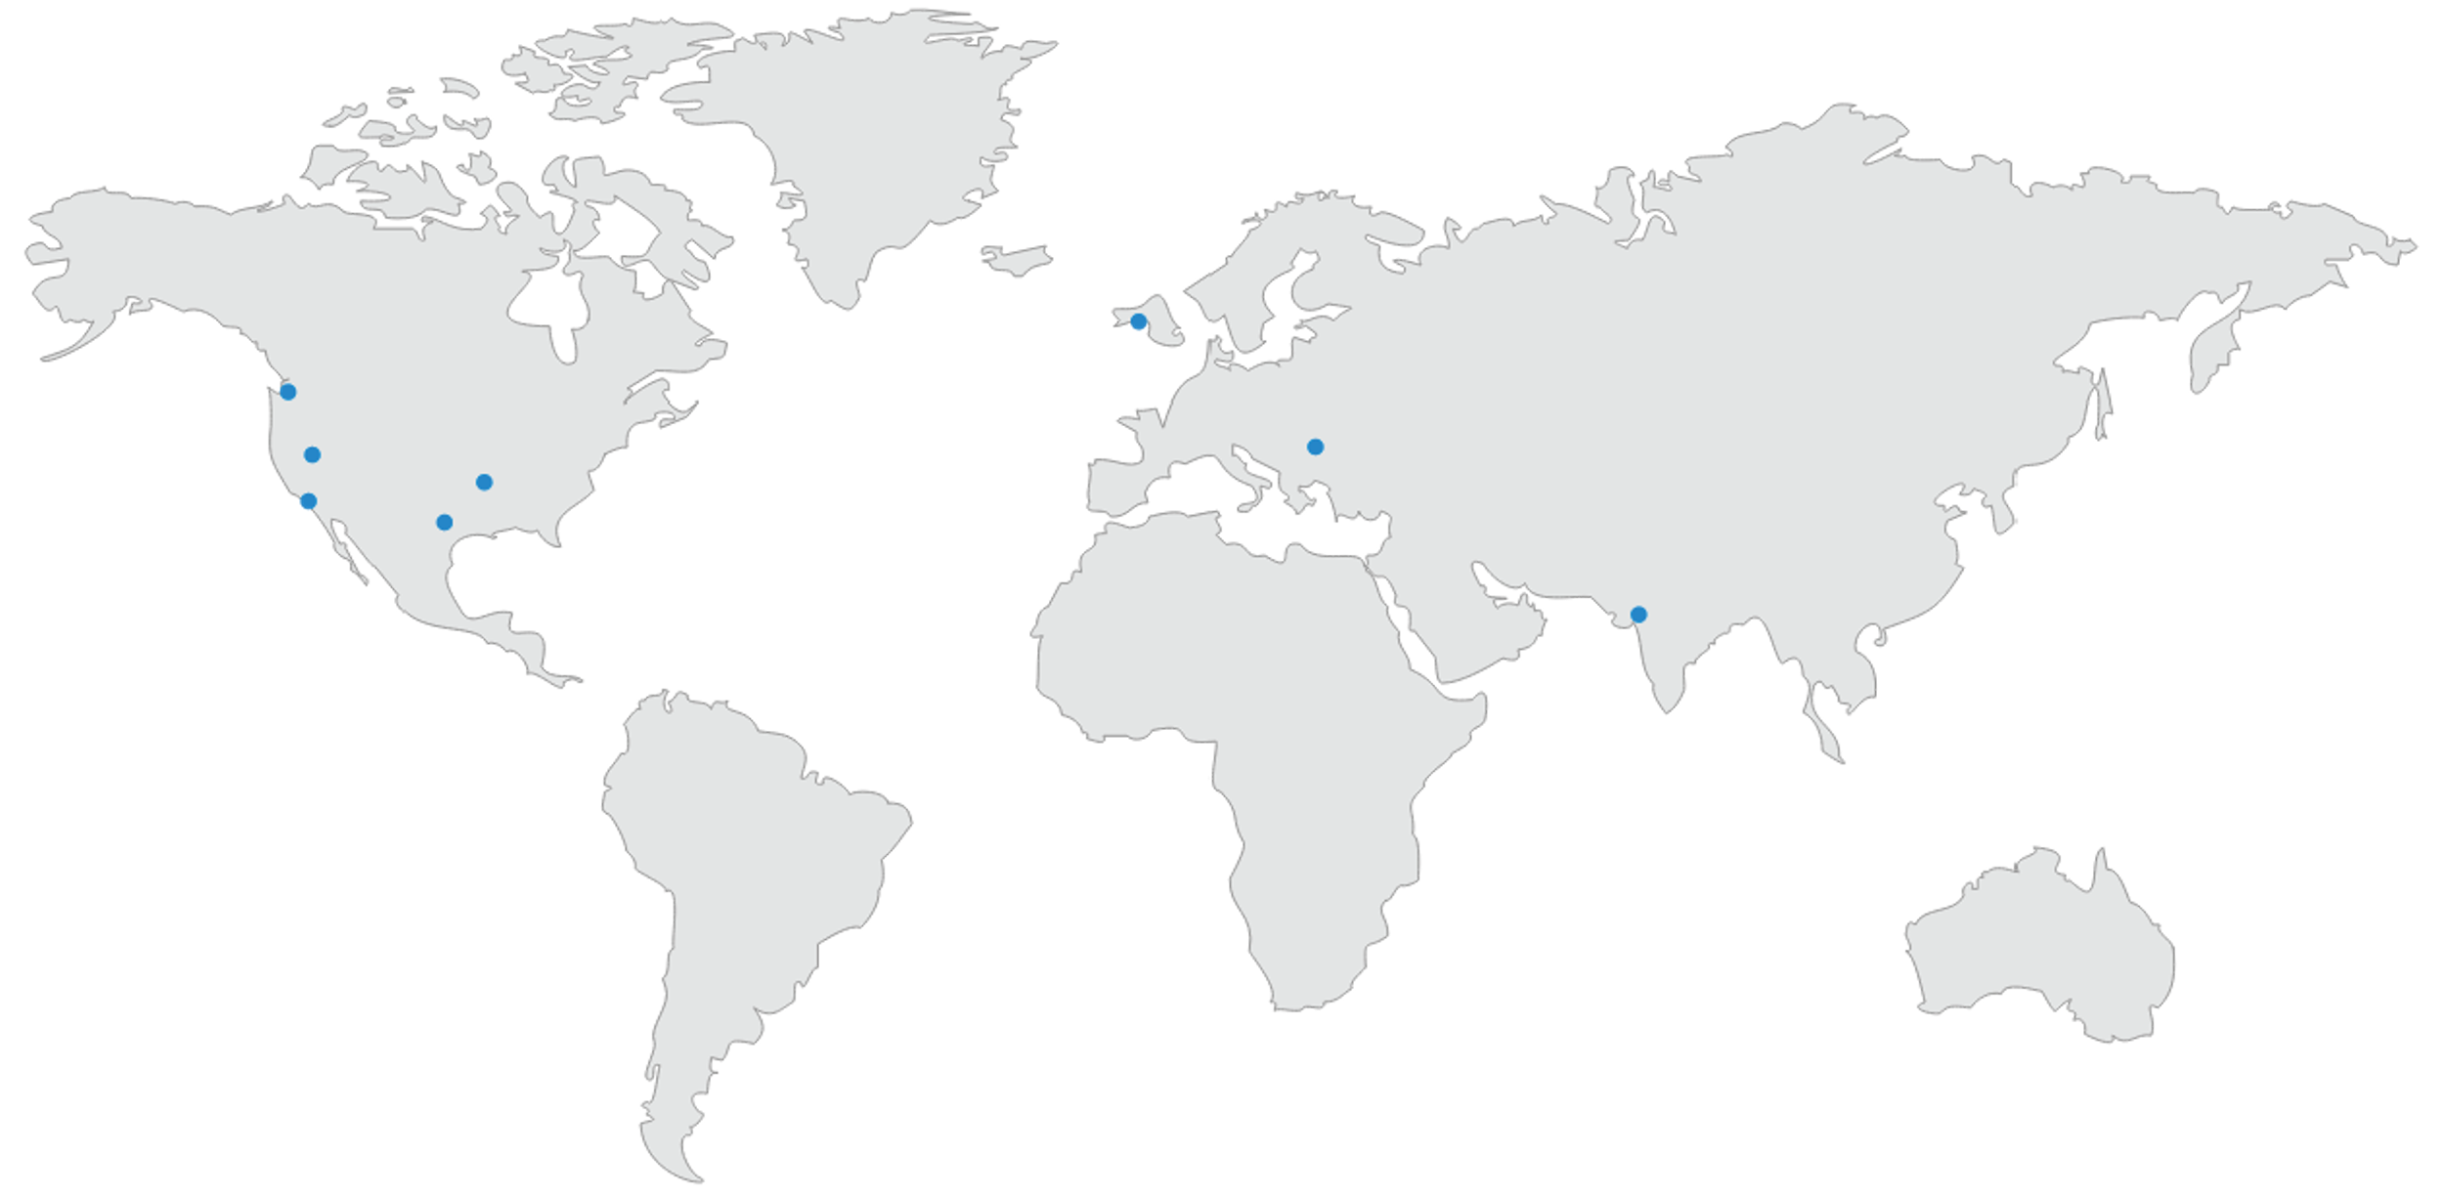

Affirma Consulting
We Are A Global Company
Contact
Affirma Consulting features a full-service digital marketing agency headquartered in the Seattle area with a global presence. As your out-of-house marketing team, we take the guesswork out of marketing and continually deliver measurable business value.
affirmaconsulting.com
425-880-9985
info@affirmaconsulting.com
Locations
United States
Washington
Nevada
California
Arkansas
Texas
Ireland
Romania
India

